Slide 1
Report

Slide 2
Task No. 1
Aim:- Performing the XSS operation on Five labs those are present on Portswigger
Steps:-
1:- Open the given link(In that there are many lab are available we have to choose those we want)
2:- When we select the lab read the description on the lab and access the lab
3:- After that see whether there is an input option or not
4:- Turn on the interception
5:- Hit the login button on the login page of the port swigger

Slide 3
Lab 1:-
Aim:- Reflected XSS into HTML content with nothing encoded
Step 1:- Open the lab
Step 2:- Access the lab
Step 3:- Enter "<script>alert(1)</script>" in search box
Step 4:- Click Search
Step 5:- Lab Solved
Conclusion: The given File contains JavaScript so when we entered the script it reflected and solved the lab

Slide 4
Lab 2
Aim:- Stored XSS into HTML context with nothing encoded
Step 1:- Open the lab
Step 2:- Access the lab
Step 3:- Enter the following into the comment box:
<script>alert(1)</script>
Step 4:- Enter a name, email and website.
Step 5:- Click "Post comment".
Step 6:- Go back to the blog.
Conclusion:- Given File contain java script so when we entered the script it reflect and solve the lab

Slide 5
Lab 3
Aim:- DOM XSS in document. Write sink using source location. Search
Step 1:- Open the lab
Step 2:- Access the lab
Step 3:- Enter a random alphanumeric string into the search box.
Step 4:- Right-click and inspect the element, and observe that your random string has been placed inside an img src attribute.
Step 5:- Break out of the img attribute by searching for:
"><svg onload=alert(1)>
Conclusion: The given File contain DOM-based cross-site script so when we entered the script it reflected and solved the lab

Slide 6
Lab 4
Aim:- DOM XSS in innerHTML sink using source location.search
Step 1:- Open the lab
Step 2:- Access the lab
Step 3:- Enter the following into the into the search box:"<img src=1 onerror=alert(1)>"
Step 4:- Click "Search".
Conclusion: The given File contain DOM-based cross-site script so when we entered the script it reflect and solve the lab

Slide 7
Lab 5
Aim:- DOM XSS in jQuery anchor href attribute sink using location.search source
Step 1:- Open the lab
Step 2:- Access the lab
Step 3:- On the Submit feedback page, change the query parameter returnPath to / followed by a random alphanumeric string.
Step 4:- Right-click and inspect the element, and observe that your random string has been placed inside an a href attribute.
Step 5:- Change return path to:"javascript:alert(document.cookie)"
Conclusion: The given File contains DOM-based cross-site script so when we entered the script it reflected and solve the lab

Slide 8
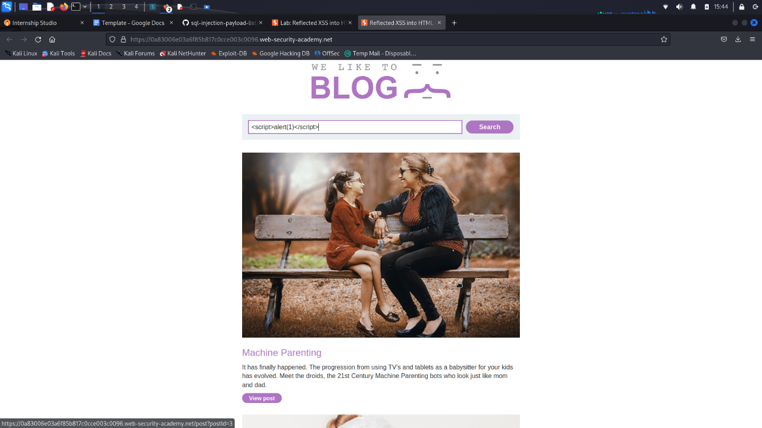

Slide 9
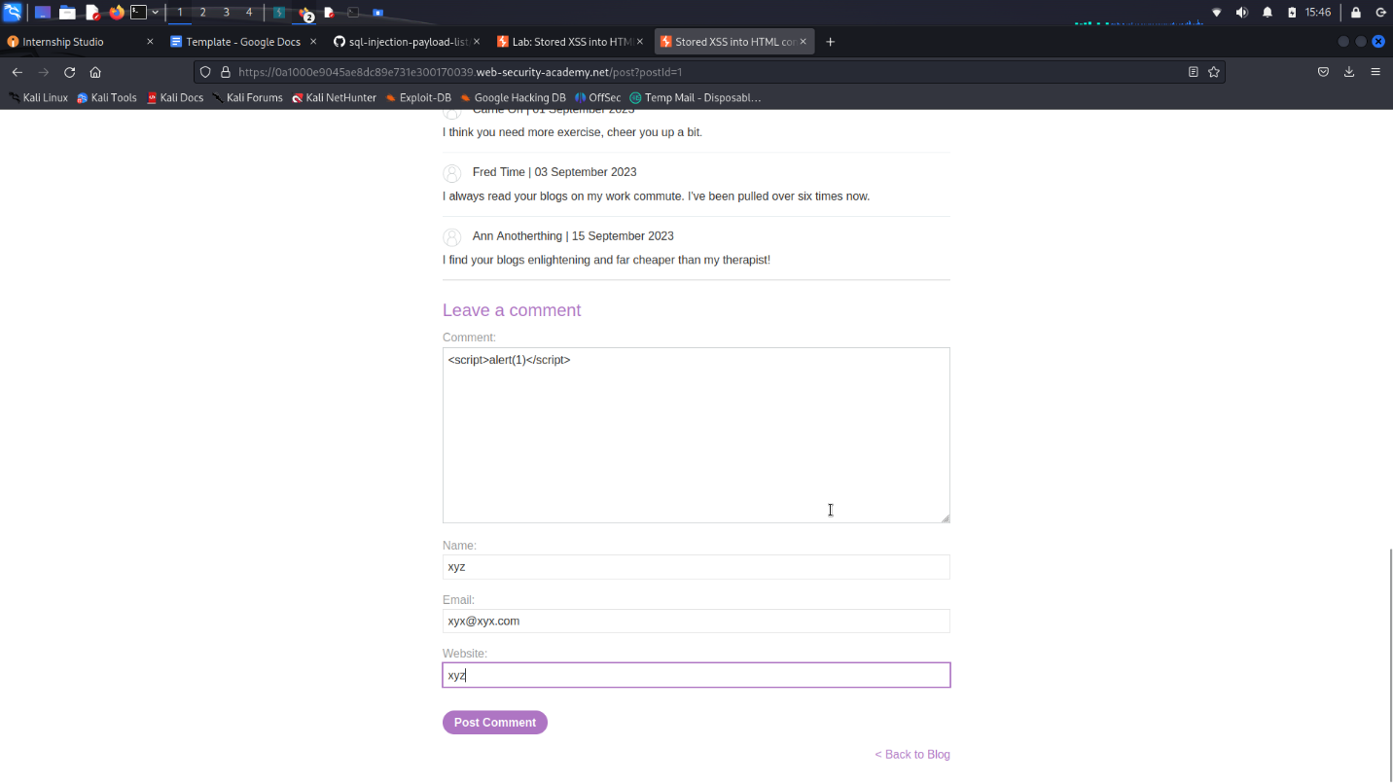

Slide 10
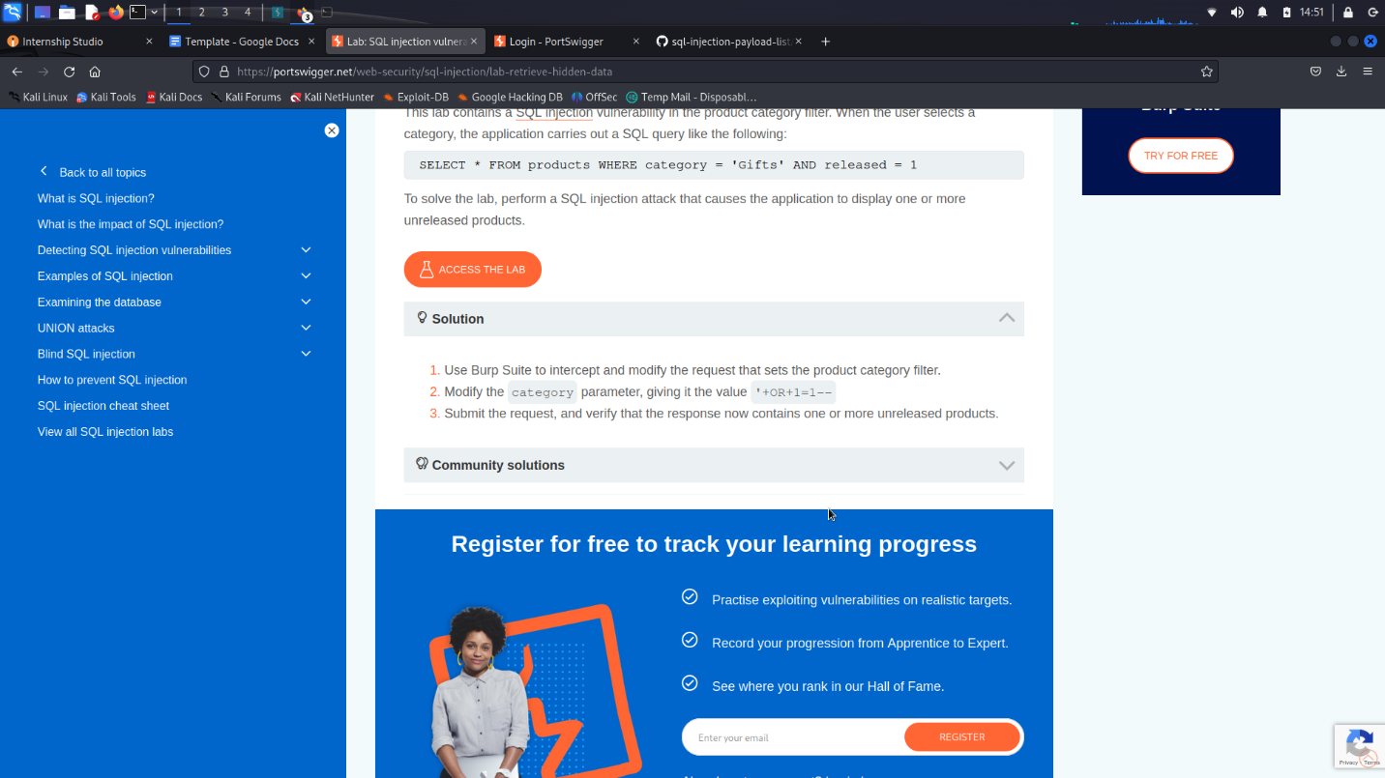

Slide 11
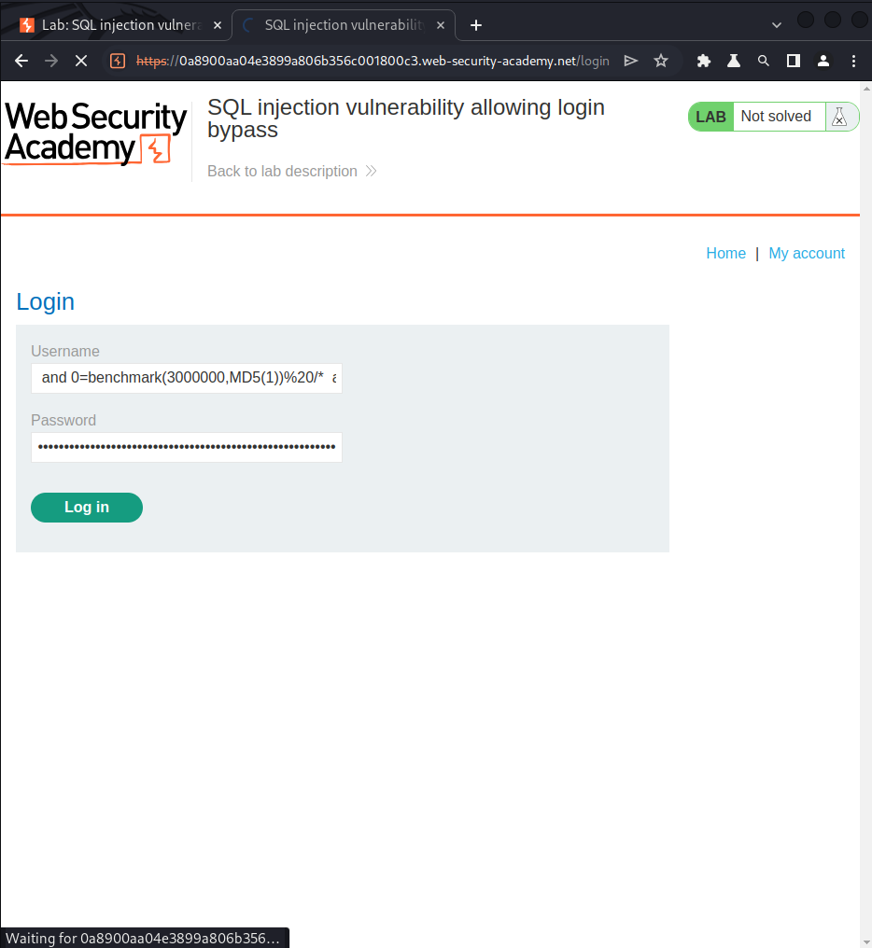

Slide 12
